Slide 1

Investing in Childcare: A Call to Action for Government Policy
By Christina Vosnak

Slide 2
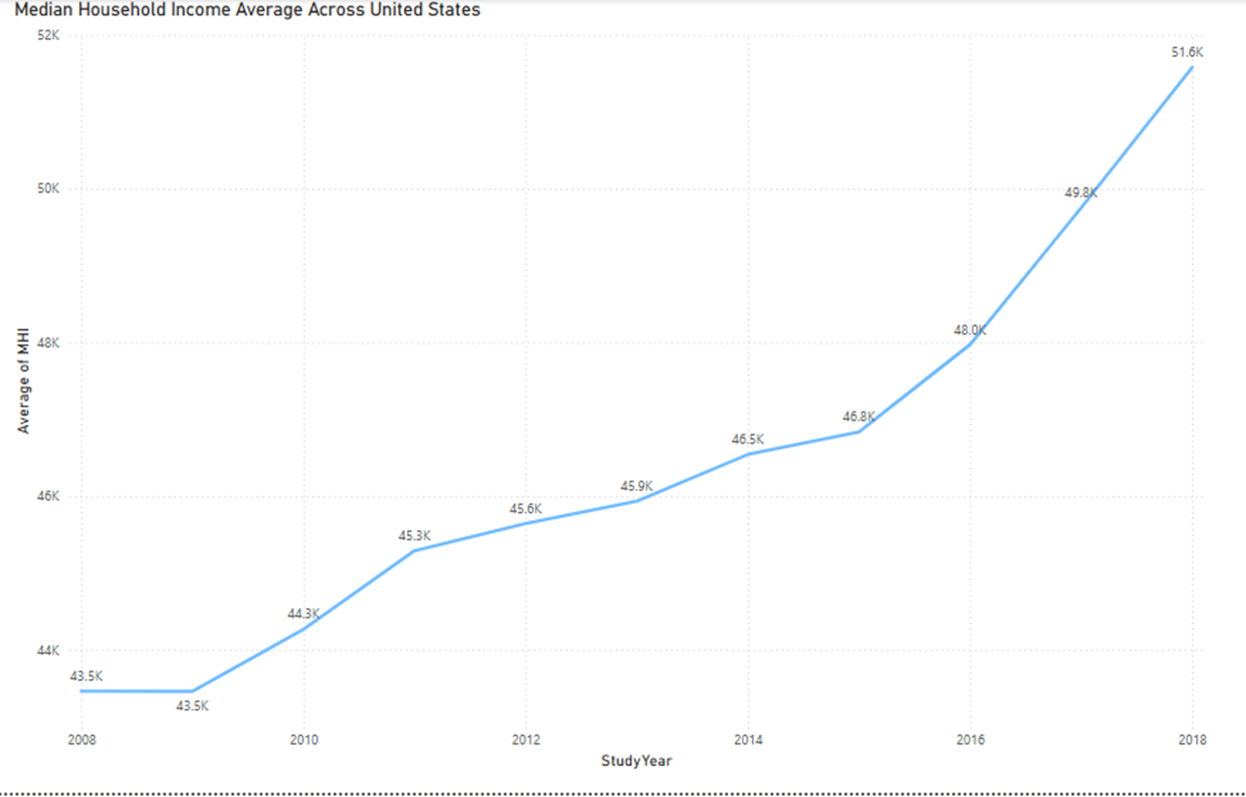
Median Household Income Over Time
2018 Average MHI: $51.8K
2008 Average MHI: $ 43.5K
10 Year Average increase of 16%

Slide 3
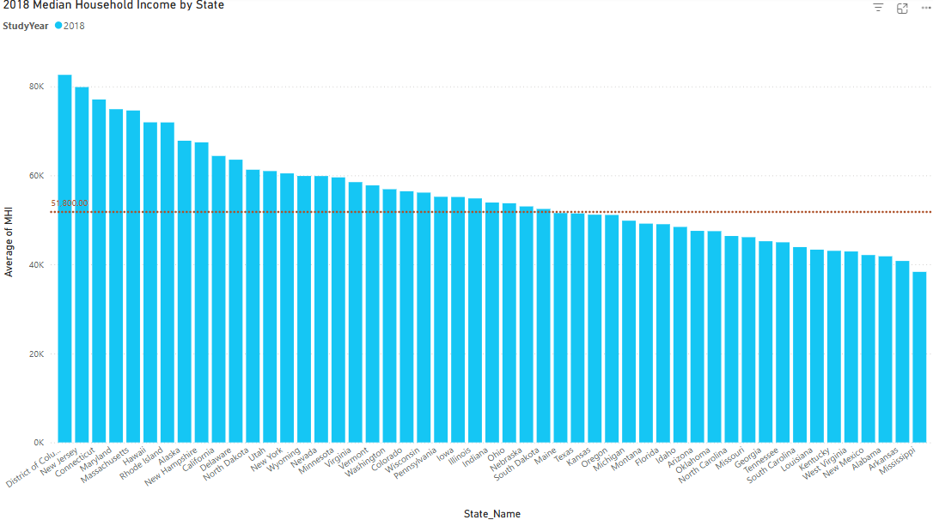
2018 Median Household Income By State

Slide 4
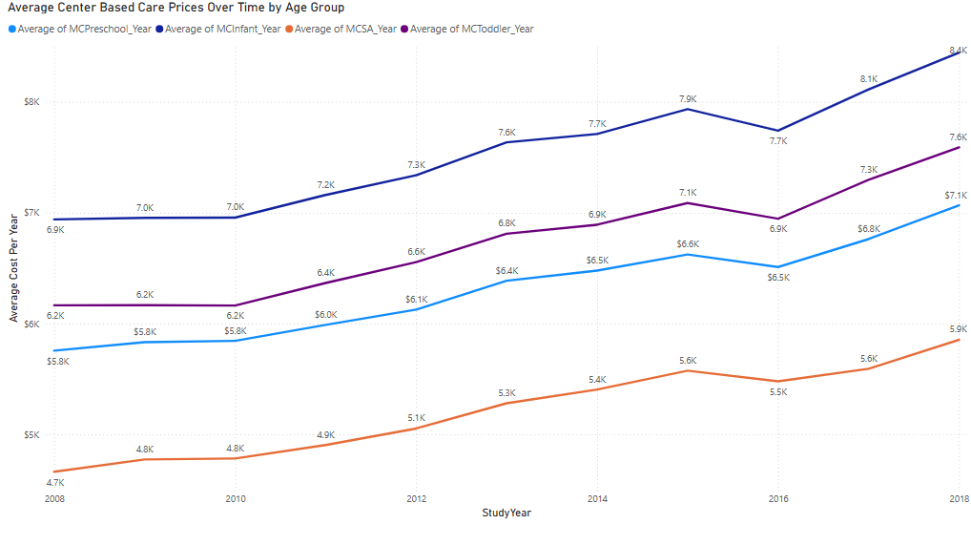
Average Center Based Childcare Cost Per Year By Age Group
2018 Infant Cost $8.4K (+18%)
2018 Toddler Cost: (+18%)
2018 Preschool Cost: $7.1K (+18%)
2018 School Age Cost: 5.9K (+20%)
Overall Based on Age Group and 10 Year span the Cost of Childcare has increased by 18%-20%

Slide 5
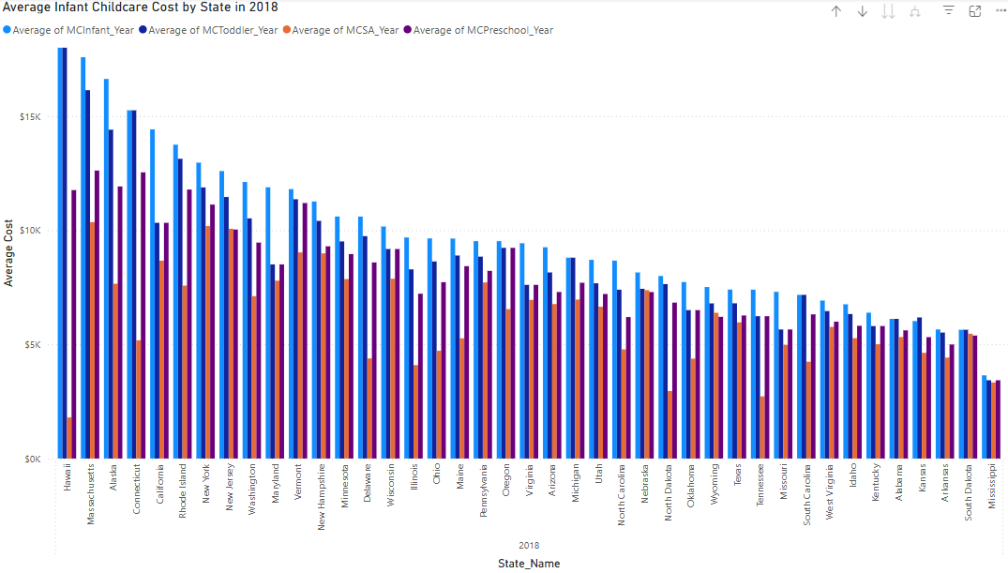
2018 Childcare Cost By State

Slide 6
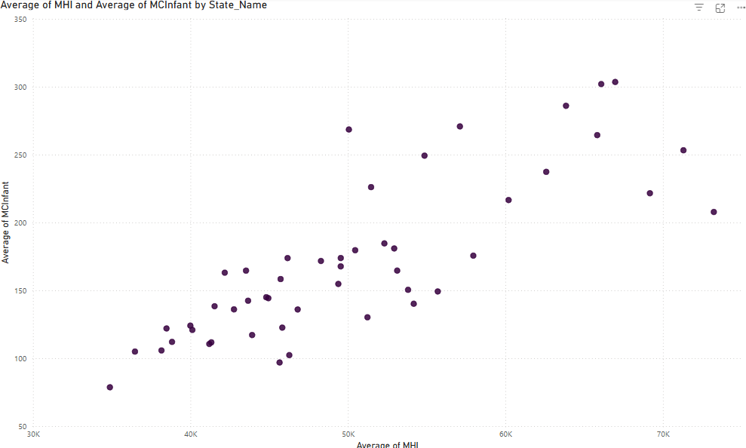
Correlation of Infant Childcare Cost to MHI
Data clearly shows there is a correlation between infant childcare costs and MHI
As MHI increases so does infant childcare, giving no break to families

Slide 7
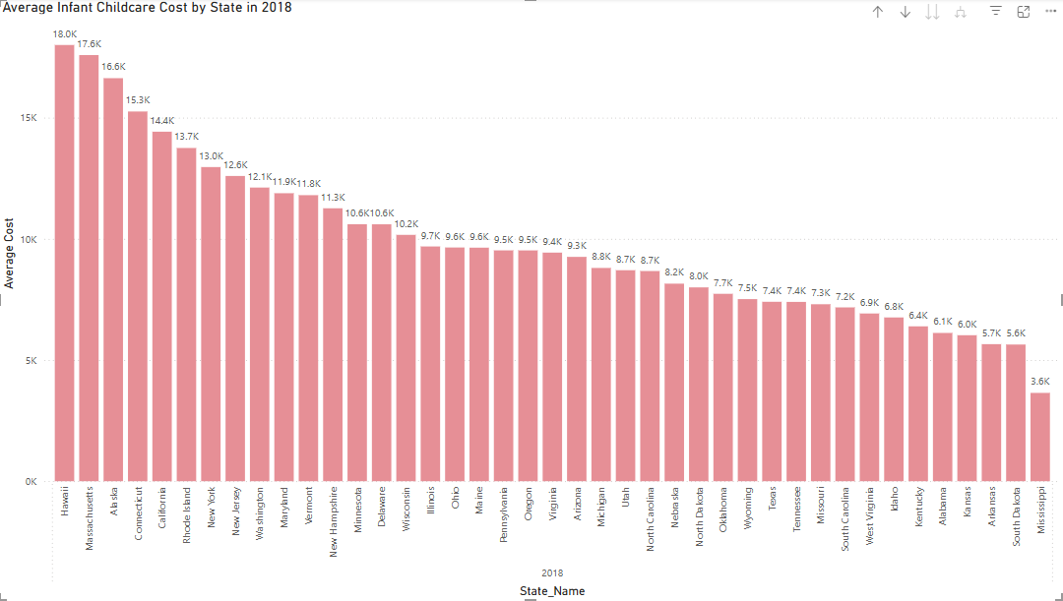
2018 Infant Childcare Cost By State
Infant Childcare is the most expensive group on average to afford for families
Infant age ranges from 0-23 months
Hawaii is the most expensive state for infant childcare

Slide 8
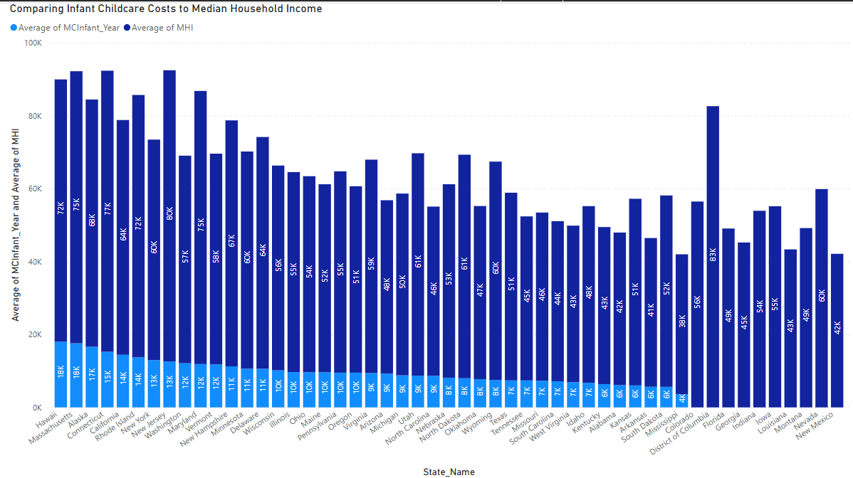
2018 MHI to Infant Childcare Ratio

Slide 9
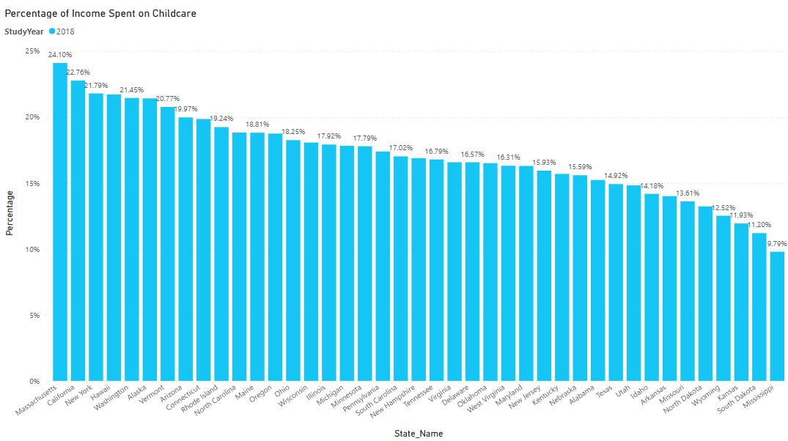
Percentage of Income Spent on Infant Childcare
Massachusetts, California, New York, and Hawaii account for Top 4 States for highest percentage of income spent on infant childcare

Slide 10
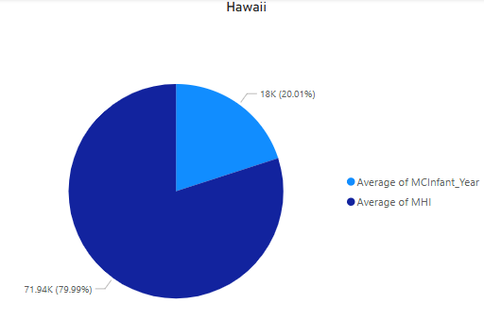
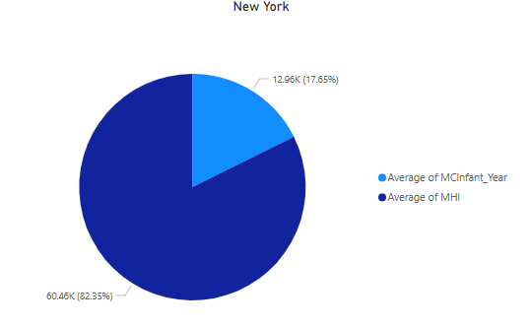
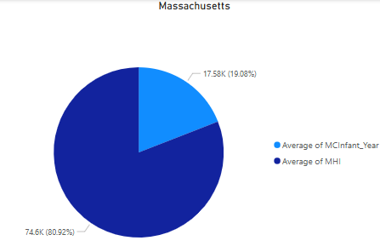

Key States

Slide 11
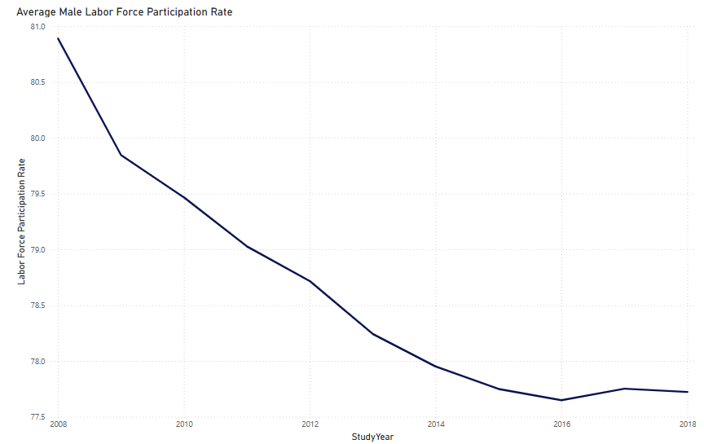
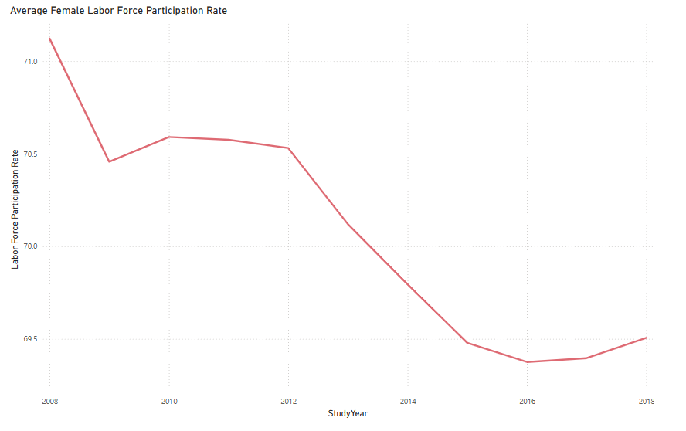
Why It Matters?
Labor Force Participation is decreasing over time between both males and females overall

Slide 12
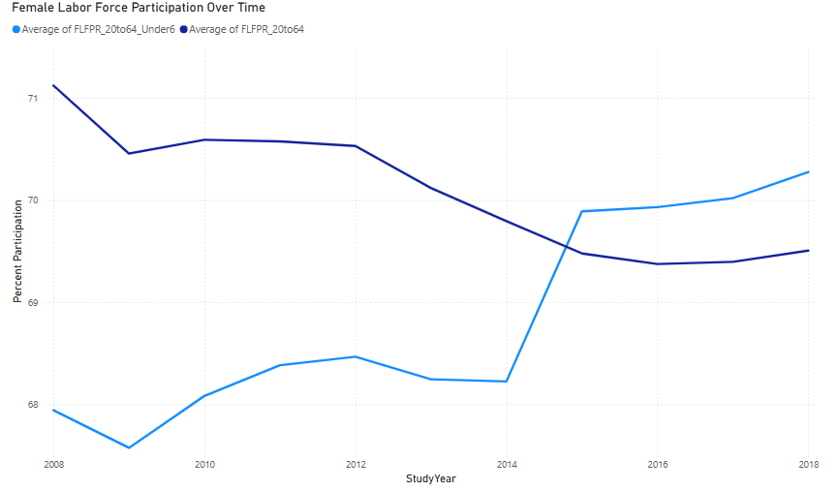
Comparing Labor Force Participation Between Females with and without Young Children
While labor force participation is trending downward, mothers with children must continue to support their families, especially those with children under the age of 6

Slide 13
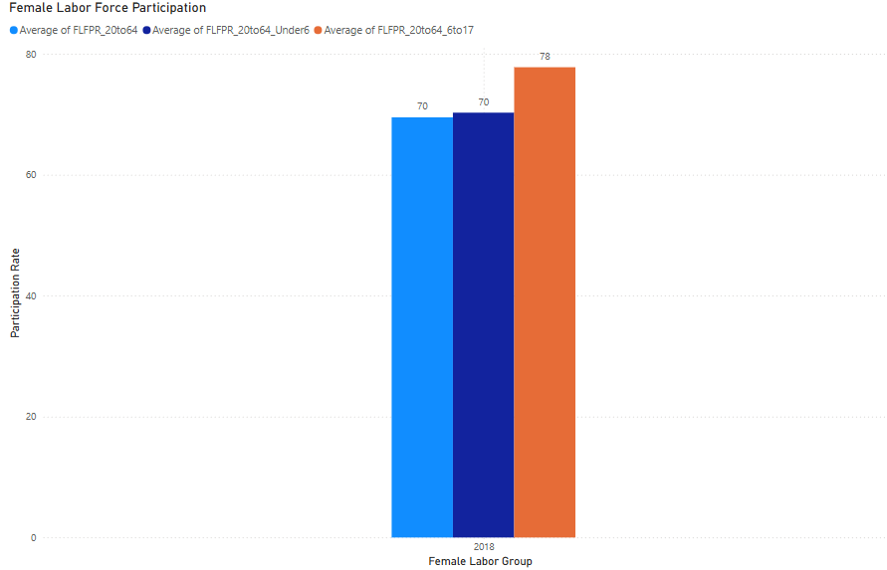
2018 Female Labor Force Participation
In 2018, the most participation from females in the labor force was those with children aged 6 to 17.
Labor force participation among females increases as children grow older.

Slide 14
Summary + Opportunity
While labor force participation is trending downward, mothers with children are more willing to participate in the labor force indicating demand for quality childcare is growing as well
Costs are increasing. It is likely women will have higher rates of labor force participation if childcare is more accessible and affordable.
Childcare costs are increasing faster than median household incomes. Creating policy to cap childcare prices or to provide affordable childcare for working families will increase labor force participation and boost the economy.

